Slide 1
3.6 First Passage Time Distribution

Slide 2

Introduction
In this section, we work only with Brownian motion, the continuous-time counterpart of the symmetric random walk.
We begin here with a martingale containing Brownian motion in the exponential function.
We fix a constant σ. The so-called exponential martingale corresponding to σ, which is

Slide 3
Theorem 3.6.1 (Exponential martingale)
Let W(t), t≥0, be a Brownian motion with a filtration F(t), t≥0, and let σ be a constant. The process Z(t), t≥0, is a martingale.

Slide 4






Proof of Theorem 3.6.1
For 0 ≤ s ≤ t, we have
E[XY|g]=XE[Y|g]
X is g-msb
F(s) measurable
E[X|g]=EX
X is independent of g
Independent of F(s)

Slide 5
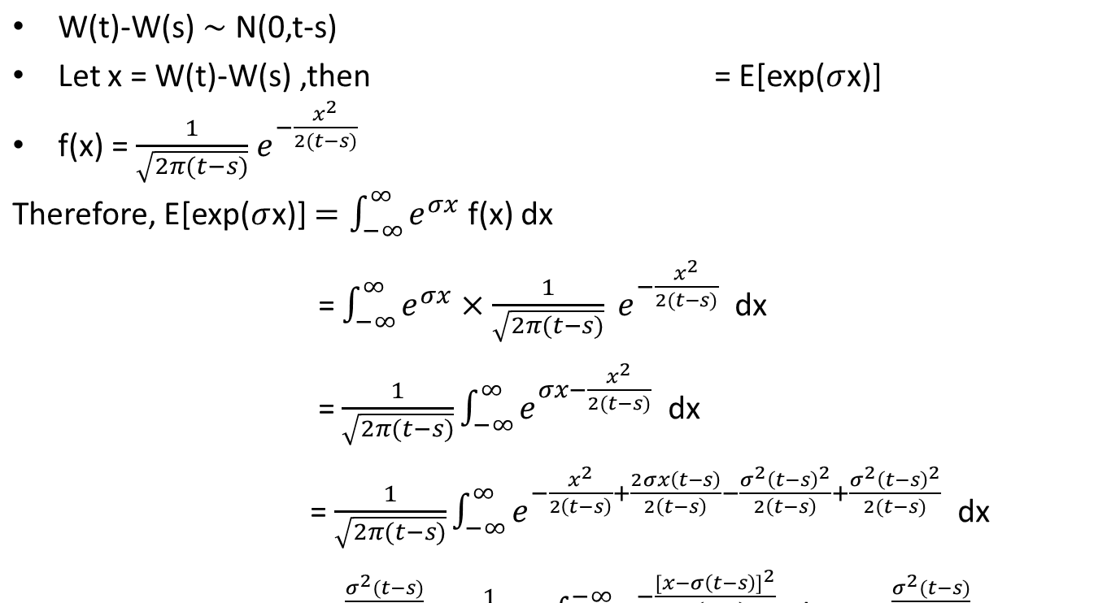


Proof of Theorem 3.6.1 (2)

Slide 6



Proof of Theorem 3.6.1 (2)
Finally, we obtain the martingale property.

Slide 7
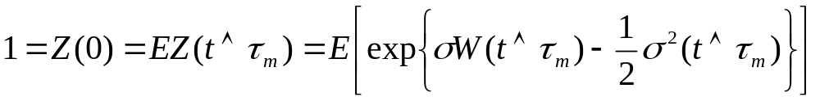

first passage time
Let m be a real number, and define the first passage time to level m
τ_{m}=min{t≥0;W(t)=m}.
This is the first time the Brownian motion W reaches the level m.
If the Brownian motion never reaches the level m, we set τ_{m}=∞
A martingale’s stopping time is still a martingale(by 上週的證明) and thus must have constant expectation. (more detail: Theorem 4.3.2 of Volume I)
Because of this fact,
where the notation denotes the minimum of t and τ_{m}

Slide 8
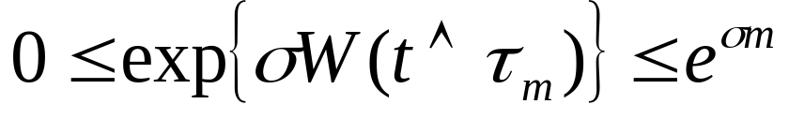

first passage time
We assume that σ>0 and m>0. In this case, the Brownian motion is always at or below level m for t ≤ τ_{m} and so

Slide 9
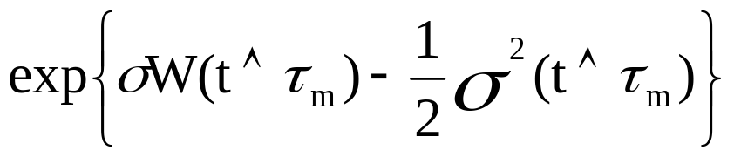
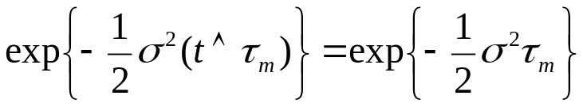
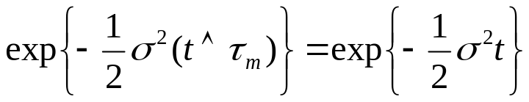
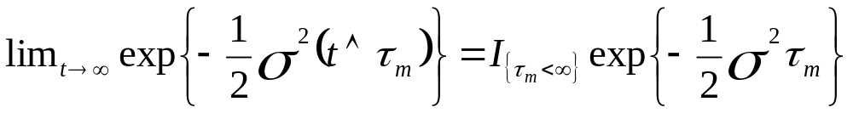
If τ_{m} <∞, the term
If τ_{m} =∞, the term
and as t→ ∞, this converge to zero.
We capture these two cases by writing
for large enough t

Slide 10
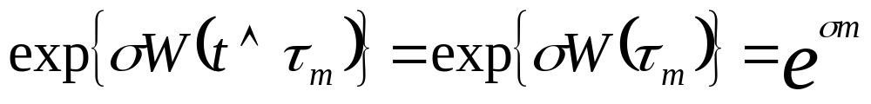

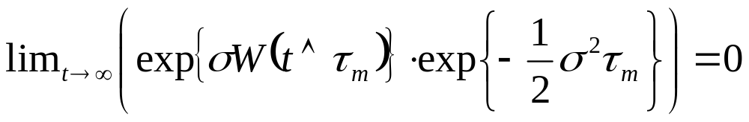
If τ_{m} <∞, then
where t becomes large enough.
If τ_{m} =∞, then we do not know what happens to
as t→∞, but we as least know that this term is bounded because of
That is enough to ensure that

Slide 11
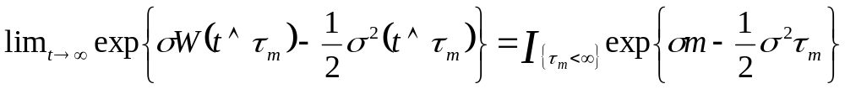

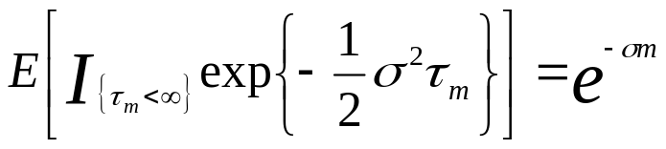
first passage time
In conclusion, we have
We take limit t
and obtain (interchange of limit and expectation, by the Dominated Convergence Theorem, Theorem 1.4.9)
or, equivalently,
hold when m and σ are positive.

Slide 12
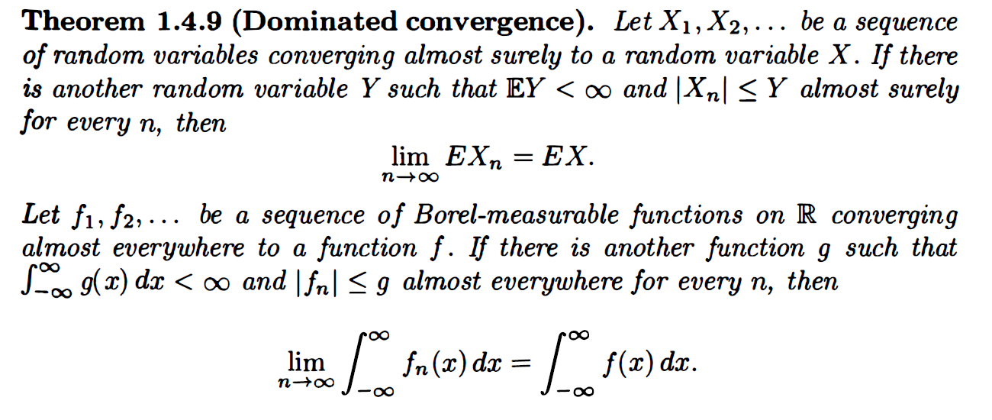

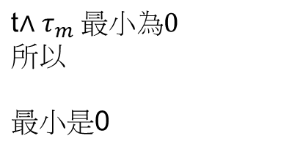


Slide 13

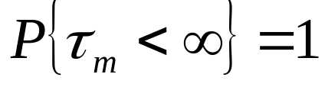
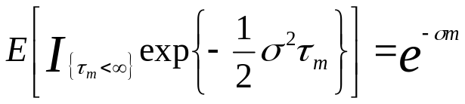
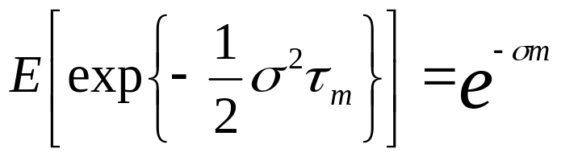
first passage time
Since it holds for every positive σ, we man take the limit on both sides as σ↓0.
This yields (use the Monotone Convergence Theorem, Theorem 1.4.5) or, equivalently,
Because τ_{m} is finite with probability one(almost surely), we may drop the indicator of this event
and obtain

Slide 14
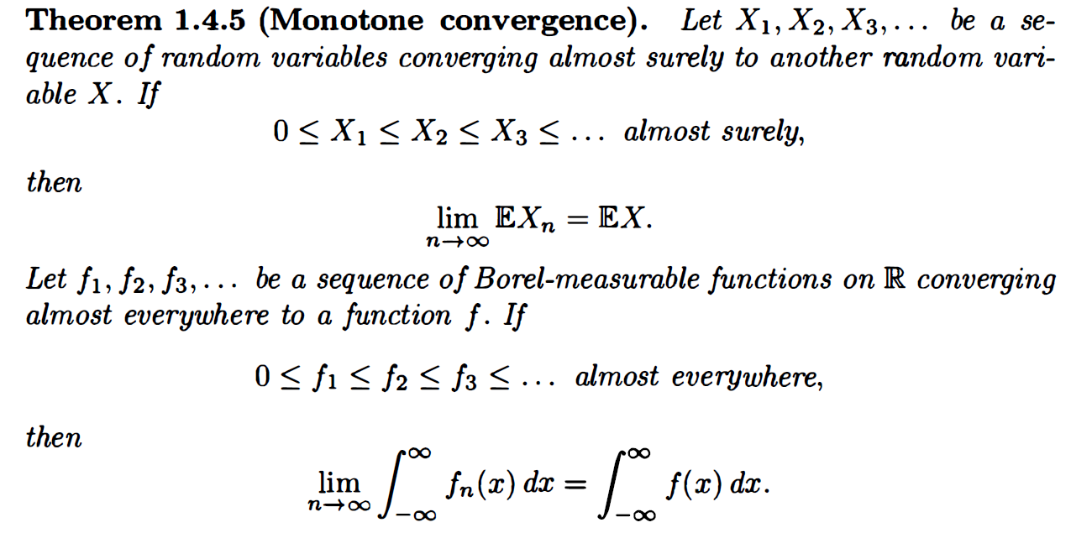

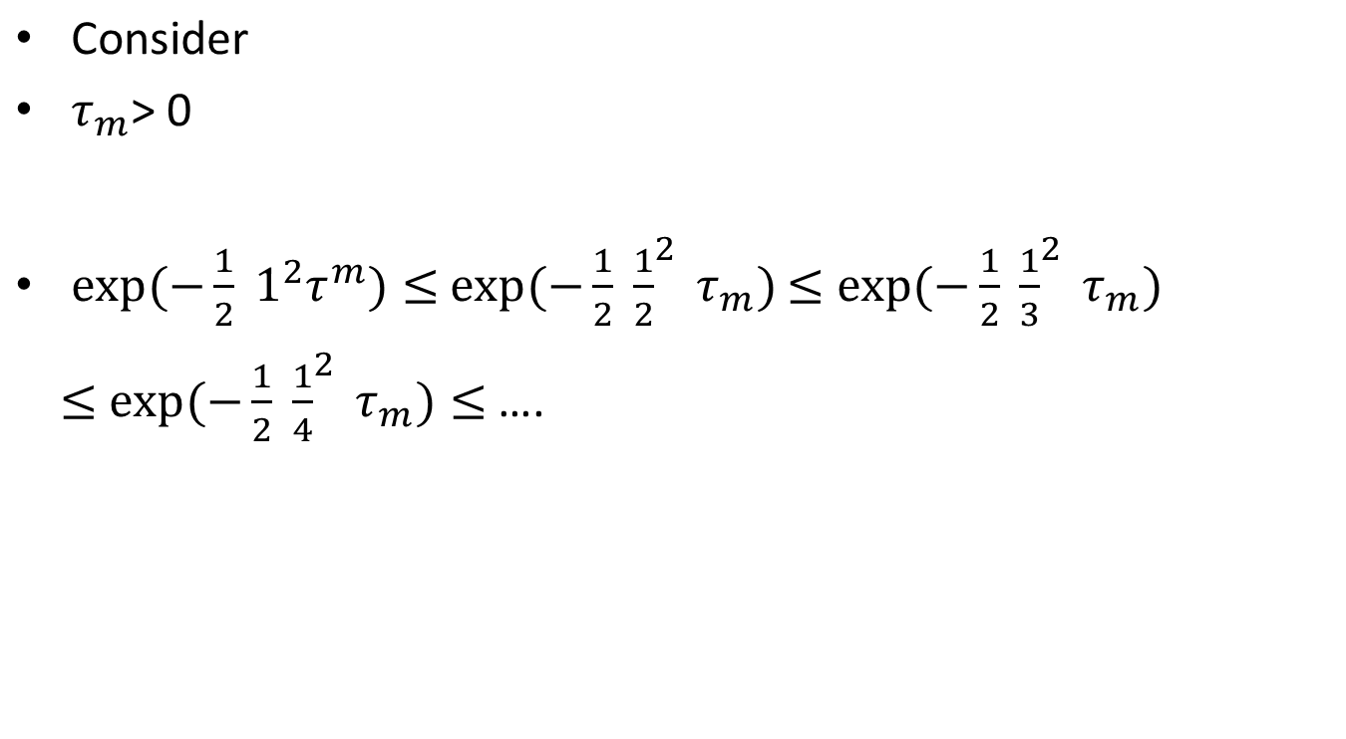

Slide 15

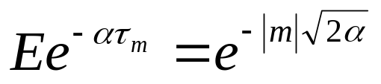

Theorem 3.6.2
For , the first passage time of Brownian motion to level m is finite almost surely, and the Laplace transform of its distribution is given by for all α>0

Slide 16



Slide 17
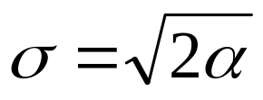
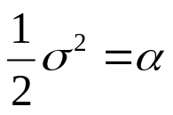

Proof of Theorem 3.6.2
(3.6.8)
When m is positive. Set , so that
3.6.8 becomes
If m is negative, then because Brownian motion is symmetric, the first passage times τ_{m} and τ_{|m|} have same distribution.
Equation
for all α>0, for negative m follows.

Slide 18
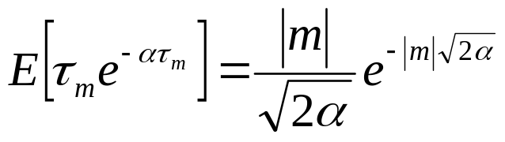

Remark 3.6.3
Differentiation of
for all α>0
with respect to α results in
for all α>0.
Letting α↓0, we obtain so long as m≠0

